Slide 1

Evaluating on the new SAT Format 2016
An analysis to understand the impact of the new format on the averages of the SAT Scores across all states for 2017 and 2018

Slide 2
Problem Statement
Since the new SAT format was released in March 2016, the College Board would like to find out if there has been any impact on the SAT scores since the implementation of the format
This project explores the trends in SAT and ACT scores for 2017 and 2018 and endeavors to identify states which may need additional assistance to equip their students for better SAT preparation

Slide 3
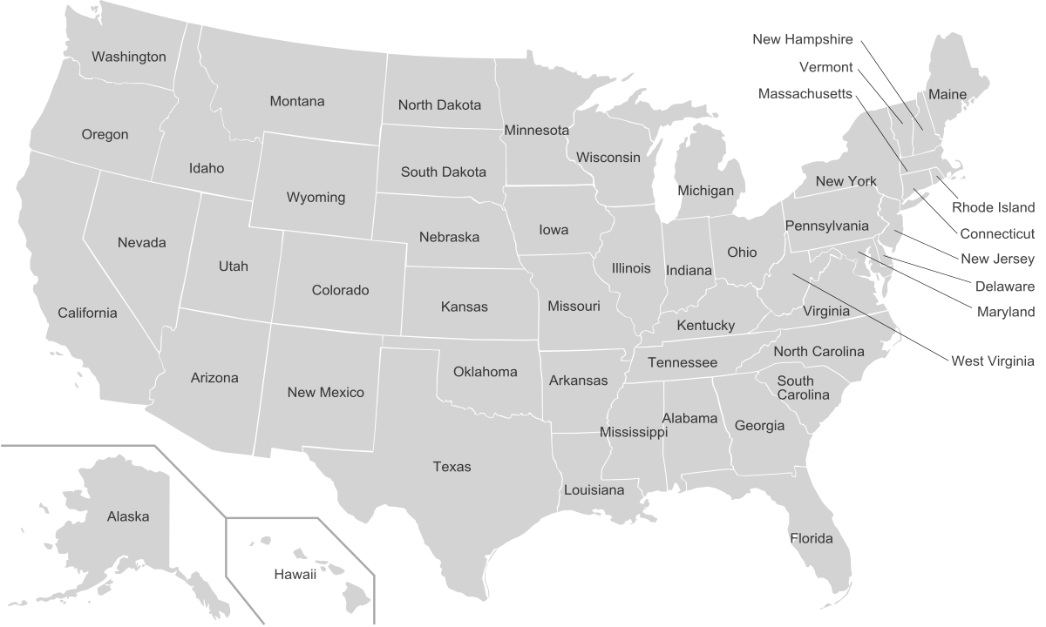
SAT 2018 Scores
Blue: top 5 performers
Red: bottom 5 performers
District of Columbia

Slide 4
SAT 2017 Scores
Blue: top 5 performers
Red: bottom 5 performers
District of Columbia

Slide 5
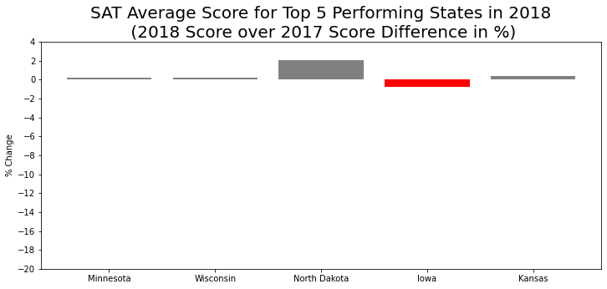
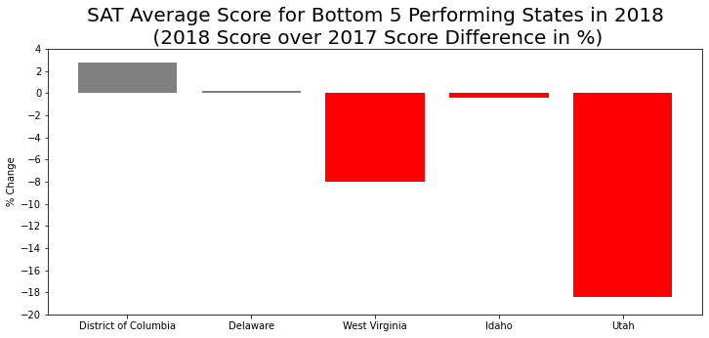
Top 5 states for SAT 2018 adjusted well to the new changes of the SAT format introduced in March 2016, but not for the bottom 5 states
#1
#2
#3
#4
#5
#1
#2
#3
#4
#5
Grey bars reflect positive score change
Red bars reflect negative score change
Further zooming in on Utah’s score, the negative change was driven by the Evidence-Based Reading and Writing section (dropped 144 points)
For West Virginia’s score, the negative change was equally driven by both both the Evidence-Based Reading and Writing Section and Math Section (dropped 42 and 45 points respectively)

Slide 6
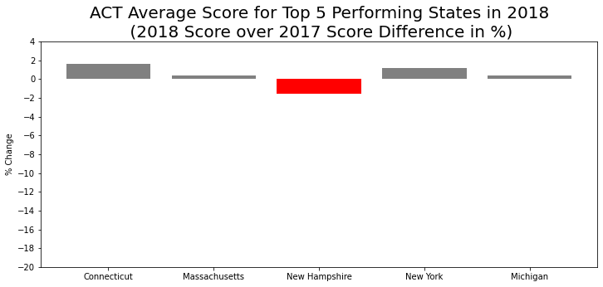
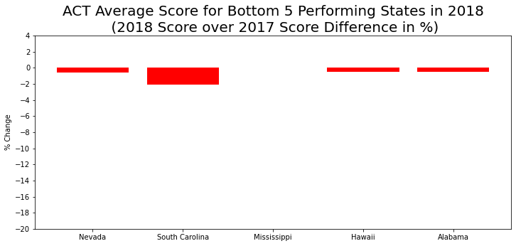
On the other hand, we see minimal changes to the ACT scores for top 5 and bottom performing states
#1
#2
#3
#4
#5
#1
#2
#3¹
#4
#5
¹ Mississippi saw 0% change
Grey bars reflect positive score change
Red bars reflect negative score change
As a comparison, 2018 ACT scores fluctuated between -2% to 2% over 2017 scores for both top 5 and bottom 5 performing states
By comparing SAT and ACT scores, we could infer that the SAT scores were more influenced by the new SAT format introduced in 2016 and less due to students who were taking the tests

Slide 7
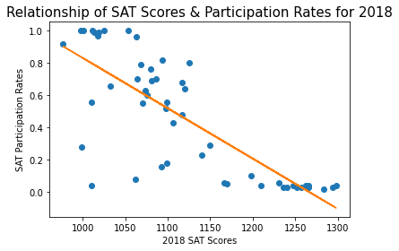
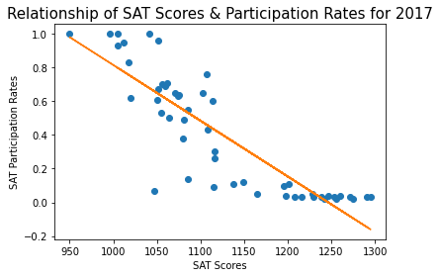
Interesting Observation: Participation rates influence SAT average scores of states for both 2017 and 2018
Interestingly, we note that states with high SAT scores had very low participation rates
This observation was applicable for both 2017 and 2018

Slide 8
Key Takeaways and Recommendations
Key Takeaways
The new SAT format impacted the scores of bottom 5 performing states
Top 5 performing states adapted well to the new SAT format
Bottom 5 states saw drops in scores after the new format was implemented
Recommendation
More SAT preparation support for the lowest 5 performing states, particularly for Utah which saw a noticeable drop in score
Specific support on Evidence-Based Reading and Writing SAT Section should be given to Utah students
Improve the exam format based on continuous feedback after encouraging more participation across the states
Limitations
The low SAT participation rates for top performing states may be influencing their SAT scores, therefore we advise to improve those participation rates for a more accurate study of this project

